Slide 1
Database Fundamentals Module 5: Working with Non-Relational Data
Chris Randall and Graeme Malcolm

Slide 2

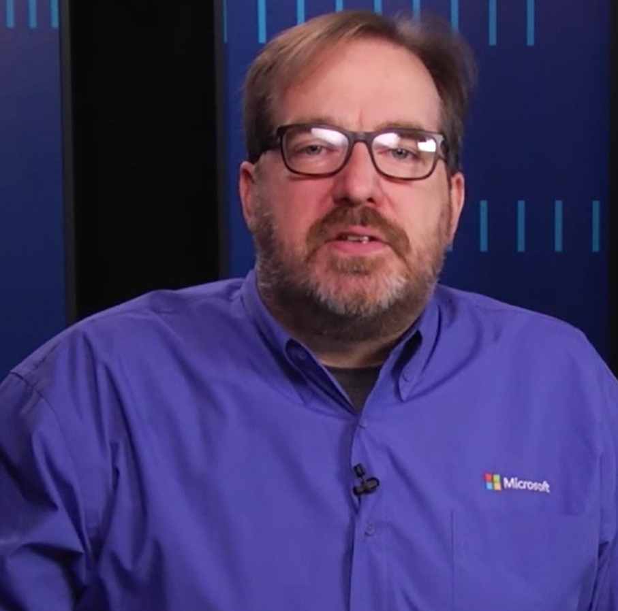
Welcome back! So what’s next Chris?
Well Graeme, now we’re going to talk non-relational types of data and storage

Slide 3
XML
Chris Randall and Graeme Malcolm

Slide 4
<?xml version="1.0" encoding="ISO-8859-1"?>
<order id="123456" date="2015-01-01">
<salesperson id="123">
<name>Graeme Malcolm</name>
</salesperson>
<customer id="921">
<name>Chris Randall</name>
</customer>
<!-- an order may contain multiple items -->
<items>
<item id="561" quantity="1"/>
<item id="127" quantity="2"/>
</items>
</order>
processing instruction
element
text
comment
shorthand syntax for closing empty elements
attribute – order is not enforced
Notes:
XML - What is it?
XML – eXtensible Markup Language
Describes data structures and values
Case-sensitive!
Why work with XML data in SQL Server and Azure SQL Database?
You need to share, query, and modify XML in an efficient and transacted way
You have both relational and XML data and need to have interoperability
You need to build cross-domain applications and need portability of data
Your data is sparse or you do not know the structure of your data
You want the server to guarantee that the XML is well-formed and optionally validate your data against a schema
You want to index your XML data for high query performance
You want to store and query relational data, but use XML as an interchange format

Slide 5
SELECT TOP 5 LastName
FROM SalesLT.Customer
FOR XML AUTO, ROOT('Customer')
SELECT *
FROM OPENXML (@idoc, '/ROOT/Customer',1)
WITH (CustomerID varchar(10), ContactName varchar(20));
LastName
Gee
Harris
Carreras
Gates
Harrington
CustomerID | ContactName
VINET | Paul Henriot
LILAS | Carlos Gonzlez
<Customer>
<SalesLT.Customer LastName="Gee" />
<SalesLT.Customer LastName="Harris" />
<SalesLT.Customer LastName="Carreras" />
<SalesLT.Customer LastName="Gates" />
<SalesLT.Customer LastName="Harrington" />
</Customer>

Slide 6
XML Support In SQL Server and Azure SQL Database
Feature | Description
xml data type | Store XML in variables and columns
XQuery | Node-tree query language for XML
XML Indexes | Optimize XQuery performance
XSD Schemas | Enforce type validation for XML data
FOR XML clause | Generate XML from relational data
OPENXML function | Generate relational data from XML

Slide 7
XML
Exporting query results to XML
Working with the native XML datatype

Slide 8
JSON
Chris Randall and Graeme Malcolm
Notes:
NoSQL doesn’t mean saying NO to SQL, but rather Not Only SQL. It’s about recognizing that for some problems
other storage solutions are better suited!

Slide 9
JSON (JavaScript Object Notation) is a lightweight data-interchange format.
Easy for humans to read and write
Language independent
Same syntax as JavaScript Objects
Can be used to store application data
Store in SQL Server as NVARCHAR, or use DocumentDB
Notes:
Values, objects, arrays

Slide 10
JSON Objects
Name/value pairs using colons
Enclosed by curly braces
Pairs separated by commas
{
name:value,
name:value
}
Notes:
JSON objects and arrays can be nested

Slide 11
SELECT TOP 5 LastName
FROM SalesLT.Customer
FOR JSON AUTO
declare @json nvarchar(255)
set @json =
N'[ null, "string", 1, true]';
select *
from OPENJSON( @json )
LastName
Gee
Harris
Carreras
Gates
Harrington
[{"LastName":"Gee"},
{"LastName":"Harris"},
{"LastName":"Carreras"},
{"LastName":"Gates"},
{"LastName":"Harrington"}]
Key | Value | Type
0 | Null | 0
1 | String | 1
2 | 1 | 2
3 | True | 3
Notes:
When you call OPENJSON with the default schema - that is, when you don't specify an explicit schema in the WITH clause - the function returns a table with the following columns.
Key. An nvarchar(4000) value that contains the name of the specified property or the index of the element in the specified array. The key column has a BIN2 collation.
Value. An nvarchar(max) value that contains the value of the property. The value column inherits its collation from jsonExpression.
Type. An int value that contains the type of the value. The Type column is returned only when you use OPENJSON with the default schema. The type column has one of the following values.
Value of the Type column
JSON data type
0 null
1 string
2 int
3 true/false
4 array
5 object

Slide 12
JSON
Exporting query results to JSON
Storing JSON data in the NVARCHAR data type

Slide 13
DocumentDB
Chris Randall and Graeme Malcolm

Slide 14




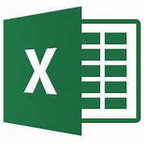


{
"id": "13244_user",
"firstName": "John",
"lastName": "Smith",
"age": 25,
"employmentHistory" : [
{
"company":"Contoso Inc"
"start": {"date":"Thu, 02 Apr 2015 20:54:45 GMT", "epoch":1428008086},
"position":"CEO"
},
{
"start": {"date":"Thu, 02 Apr 2012 20:54:45 GMT", "epoch":1428008086},
"end": {"date":"Thu, 01 Apr 2015 20:54:45 GMT", "epoch":1428008086},
"position":"GM"},
],
"address":
{
"streetAddress": "21 2nd Str",
"city": "New York",
"state": "NY",
"postalCode": "10021"
},
"children": [
{"name":"Megan", "age":10},
{"name": "Bruce", "age":7},
{"name": "Angus", "sports" : ["football", "basketball", "hockey"]}
]
"mobileNumber": "212 555-1234"
}
What is a JSON document?
What is a Document Database?
Flexible query options
ORM
Data normalization
Come as you are
Non-relational, no schema enforced
Notes:
THIS SLIDE IS ANIMATED
Click
What is a document?
It is a NoSQL document-oriented database, which saves “Key-Value” pairs of records. It is comparable in principle to other NoSQL document-oriented databases such as MongoDB. It is
Click
What is a document database??
Click
A document-oriented database is a type of NoSQL database which is used for saving, retrieving and managing “semi-structured” data. “Semi-structured” means that each record (i.e. “document”) can have its own internal structure of fields, sub-fields and sub-records. This is in contrast to a relational database where every table is strongly defined by a specific list of columns and types.

Slide 15
Azure DocumentDB
Fully-managed, highly-scalable, NoSQL document database service
{ }
JS
SQL
query over schema-free JSON
multi-document
transactions
tunable, high performance
fully managed and designed for massive scale
Notes:
Guaranteed low latency
DocumentDB guarantees less than 10 ms latencies on reads and less than 15 ms latencies on writes for at least 99% of requests. DocumentDB leverages a write-optimized, latch-free database engine designed for high-performance solid-state drives to run in the cloud at global scale. Read and write requests are always served from your local region while data can be distributed to other regions across the globe.
Replicate data globally
Easily build apps at planet scale without the hassle of complex, multiple data center configurations. Designed as aglobally distributed database system, DocumentDB automatically replicates all of your data to any number of regions worldwide. Your apps can serve data from a region closest to your users for fast, uninterrupted access.
Achieve limitless scale
Scale throughput and storage independently and elastically—not just within one region, but across many geographically distributed regions. Add capacity to serve millions of requests per second at a fraction of the cost of other popular NoSQL databases.
Benefits of SQL and JavaScript, schema-free
Query using familiar SQL and JavaScript syntax over document and key-value data without dealing with schema or secondary indices, ever. DocumentDB is a truly schema-agnostic database capable of automatically indexing JSON documents. Define your business logic as stored procedures, triggers, and user-defined functions entirely in JavaScript, and have them executed directly inside the database engine.
More choices for consistency
Instead of offering extreme choices between strong and eventual consistencies, DocumentDB offers four well-defined consistency levels—strong, bounded staleness, session, and eventual—for an intuitive programming model with low latency and 99.99 percent availability in the face of local and regional failures.
Enterprise grade SLAs
Focus on your application without having to deal with database infrastructure. Create a collection for data, set your throughput, and let DocumentDB handle the rest. Plus, DocumentDB uniquely offers transparent region homing for continuous operations—99.99 percent availability—in the face of failures. DocumentDB is ISO 27001, Health Insurance Portability and Accountability Act (HIPAA), and EU Model Clauses compliant. Learn more about service level agreements.

Slide 16
DocumentDB
Provisioning an Azure DocumentDB instance
Loading JSON into DocumentDB

Slide 17
Spatial Data
Chris Randall and Graeme Malcolm

Slide 18
Spatial
Querying Spatial data in SQL Server

Slide 19
Use the native XML data type for interoperability and schema enforcement
Use the NVARCHAR data type to store and work with JSON
Use Azure DocumentDB to store and work with JSON documents
Use the Spatial data type for geometry and geography

